Slide 1
Limits and Continuity
Unit 1 Day 4

Slide 2
Continuity at a POINT
A function is continuous at a if
$$\lim_{x→a}{f\left(x\right)=f(a)}$$
There are 3 important parts to this definition:
f(a) exists
The $\lim_{x→a}{f\left(x\right)}$ exists (which means $\lim_{x→a^{−}}{f\left(x\right)}$=$\lim_{x→a^{+}}{f\left(x\right)}$ ).
The two values above are equal.
A function is considered continuous if it is continuous at every point in its domain.

Slide 3
Continuity Example
Let $f\left(x\right)=\sqrt{4x+1}$. Show that f(x) is continuous at x = 2.
$f\left(2\right)= \sqrt{4\left(2\right)+1}=3$
$\lim_{x→2}{\sqrt{4x+1}=\sqrt{4\left(2\right)+1}=3}$
Since $\lim_{x→2}{f\left(x\right)=3=f(2)}$, f(x) is continuous at x = 2.

Slide 4
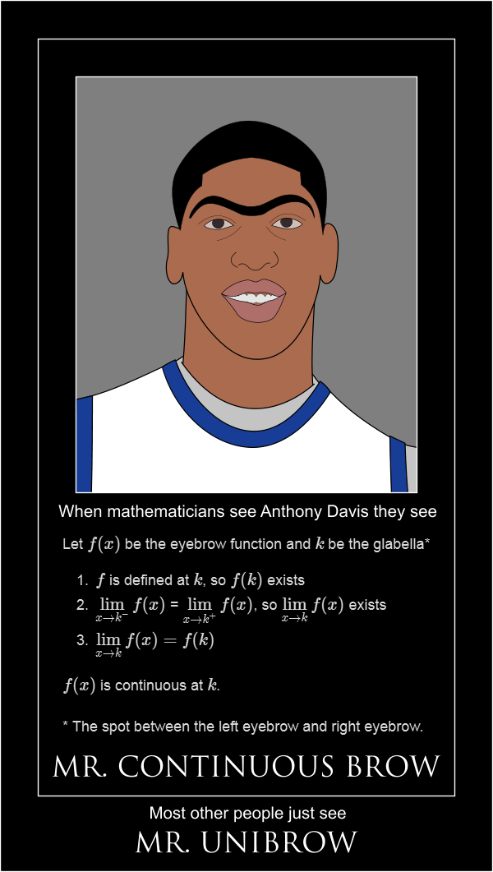
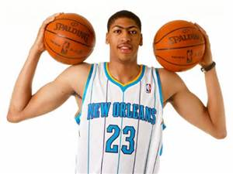
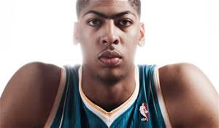
Continuity

Slide 5
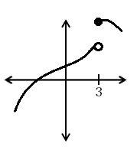
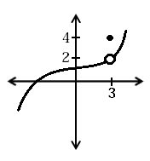
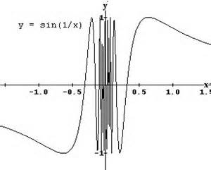
Types of Discontinuities
Non - Removable Discontinuities
Removable Discontinuity
Jump Discontinuity
Infinite (Asymptotic) Discontinuity
Oscillating Discontinuity

Slide 6
Types of Discontinuities
Non - Removable Discontinuities
Removable Discontinuity
move the point and the function will be continuous
Jump Discontinuity
Infinite (Asymptotic) Discontinuity
Oscillating Discontinuity

Slide 7
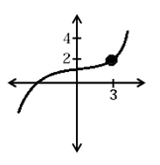
Types of Discontinuities
Non - Removable Discontinuities
Removable Discontinuity
Now continuous
Jump Discontinuity
Infinite (Asymptotic) Discontinuity
Add a point and the function will be continuous
Oscillating Discontinuity

Slide 8
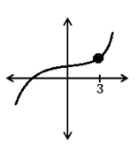
Types of Discontinuities
Non - Removable Discontinuities
Removable Discontinuity
Now continuous
Jump Discontinuity
Infinite (Asymptotic) Discontinuity
Now continuous
Oscillating Discontinuity

Slide 9
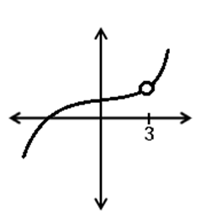
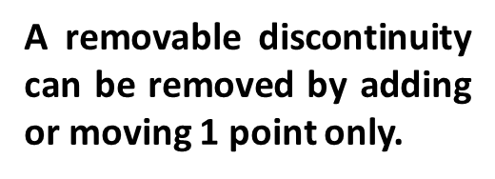
Types of Discontinuities
Non - Removable Discontinuities
Removable Discontinuity
Jump Discontinuity
Infinite (Asymptotic) Discontinuity
Oscillating Discontinuity

Slide 10
Continuity Examples
Determine where the discontinuities are and classify them as removable, infinite, jump, or oscillating. Then state the interval on which the function is continuous. Discontinuities Continuous
No discontinuities
Continuous on (-∞, ∞ )
Jump discontinuity at x = 0
Continuous on (-∞, 0) U [0, ∞ )
Removable discontinuity at x = -5
Infinite discontinuity at x = -1
Continuous on
$(−\text{∞}$, -5) u (-5, -1) U (-1, ∞)
Infinite Discontinuity at x = -3
Continuous on (-∞, -3) U (-3, ∞ )
x ≠ 0
Removable discontinuity at x = 0
Continuous on (-∞, 0) U (0, ∞ )

Slide 11
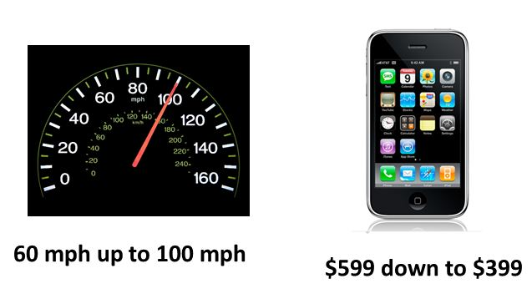
Intermediate Value Theorem
What was a speed you are 100 % sure you must have gone in the time in between? Why?
What was a speed that you could have gone in between but you aren’t so sure? Why?

Slide 12
Intermediate Value Theorem
What was a price you are 100 % sure the iphone must have been in between? Why?
What was a price that the iphone might have had in between but you aren’t 100% sure? Why?

Slide 13
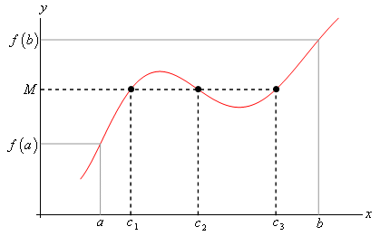
Intermediate Value Theorem
The Intermediate Value Theorem states that if f(x) is continuous in the closed interval [a,b] and f(a) M f(b), then at least one c exists in the interval [a,b] such that:
f(c) = M

Slide 14
IVT Example
Let $f\left(x\right)=x^{3}−x−1.$ Show that f(x) has a zero.
$f\left(1\right)=−1$
$f\left(2\right)=5$
f(x) is continuous on [1,2] so by the IVT, there must be a value on [1,2] where f(x) = 0.

